Slide 1
PROJECT MANAGEMENT SYSTEM
NAME : URVAL SHAH
ROLL NO : 130
ENROLL.NO : 22002170110170
BATCH : DIV 5
BRANCH : CE

Slide 2
INTRODUCTION
This project is based on projects of the student which keeps the record of the student details and their project details.
At first faculty inserts all records of student like name, roll.no, division, enroll-num, titles of the project.
Then the system goes to project co-Ordinator and they will give marks to particular student according to their performance.
Basically this system gives the marksheet and rank of the student basis on their marks.

Slide 3
FUNCTIONALITIES
Insertion of students details with their project titles.
Sorting according to roll no of student.
Deletion of student details having same id/roll-no.
Searching for student to give marks.
Sorting in reverse order to get student having highest marks.
Counting number of student.
Displaying the student marks with their project name.
Displaying marksheet and rank list containing all student having all details.

Slide 4
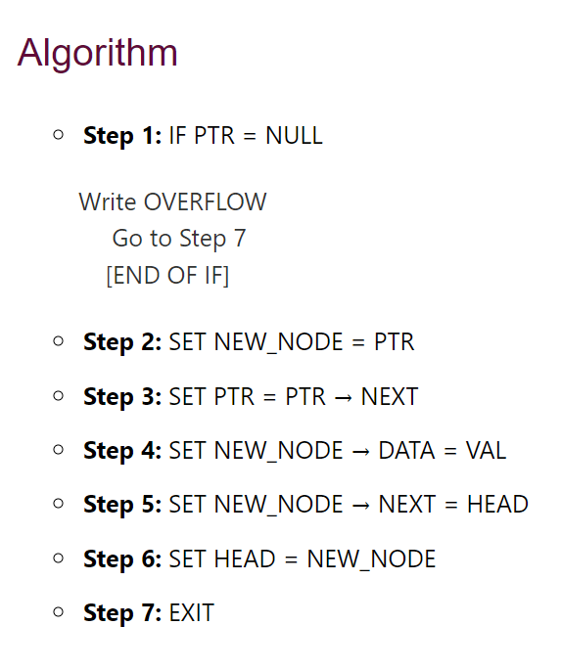
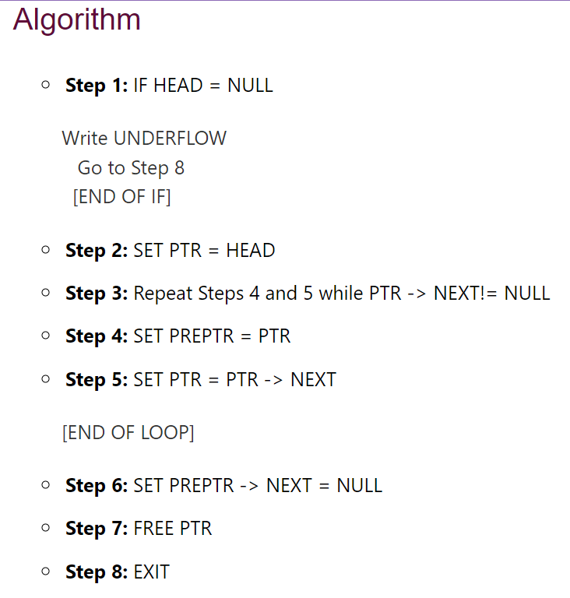
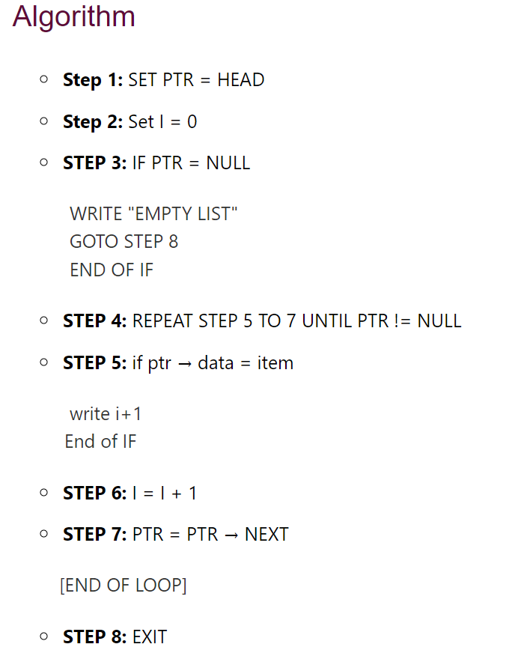
ALGORITHM
INSERTION
DELETION
SEARCHING

Slide 5
MERITS AND DEMERITS
MERITS
DEMERITS
Dynamic in size.
Time complexity.
Data management.
Efficient sorting.
Efficient insertion and deletion.
Graphical representation is not there.
Graphical user interface is not there.
More memory required.
Output on console.

Slide 6
FUTURE SCOPE
In future, by using graphical user interface this project will work as a perfect system with frontend and backend development.
There will be a graphical representation of this all data to see where it stores.
We can connect this program with database to keep this all data in tabular form.

Slide 7
THANKING YOU
FOR WATCHING THIS

